Slide 1

BUSINESS & DATA ANALYTICS TASK
TOP ELEVEN

Slide 2

Contents
1. Introduction to the issue
2. Q1: Is VALE achieving its goal?
3. Q2: Does VALE impact the behavior of watching video ads on regular placements?
4. Conclusion

Slide 3
Did you know that free-to-play games generate profit from only 1% of their player base? Keeping that in mind, it's important to engage players who do not necessarily want to spend money directly in the game (InAppPurchase) and also give them a chance to advance and earn extra points. Video Ads monetization is one way to do it! In this concept, external third-party provides advertising videos (video ads) which are shown to the players in the game. So, it's a win-win situation where players invest time to earn in-game rewards while the game developer can generate profit.

Slide 4
Top Eleven - Be a Football Manager is played by millions from all over the world, generating terabytes and terabytes of data for us to analyze. There are two main ways Top Eleven managers can get rewards from video ads: 1. Regular Video Ads Placements 2. Video Ads placements within Live Events - VALEs

Slide 5
VALE is a relatively new feature in Top Eleven, and its goal is to monetize users that usually do not watch video ads on regular placements, nor are in-game payers (spend money directly in the gamE)

Slide 6
HOW DOES VIDEO ADS LIVE EVENT (VALE) WORK?
VALE is a time-limited event, where managers can watch a video ad, and get one player attribute point as a reward (one out of fifteen attributes). Here is how it works:
Before watching every video ad, the manager chooses one out of three reward lanes, ATTACK/MIDFIELD/DEFENCE. Each lane represents the subset of player attributes the manager would like to get
The reward is received when the whole video is watched. Then, the manager chooses one of their players to which the reward will be applied
Each reward has a random multiplier effect of 1,2,5 or 10 (e.g.: a multiplier of 10 means that 10, instead of 1, player attribute points will be assigned to a previously chosen player).
After every batch of four video ads is watched within VALE, the manager needs to wait 8 hours before getting the new batch of 4 available video ads (8 hours after the fourth video in the batch).

Slide 7
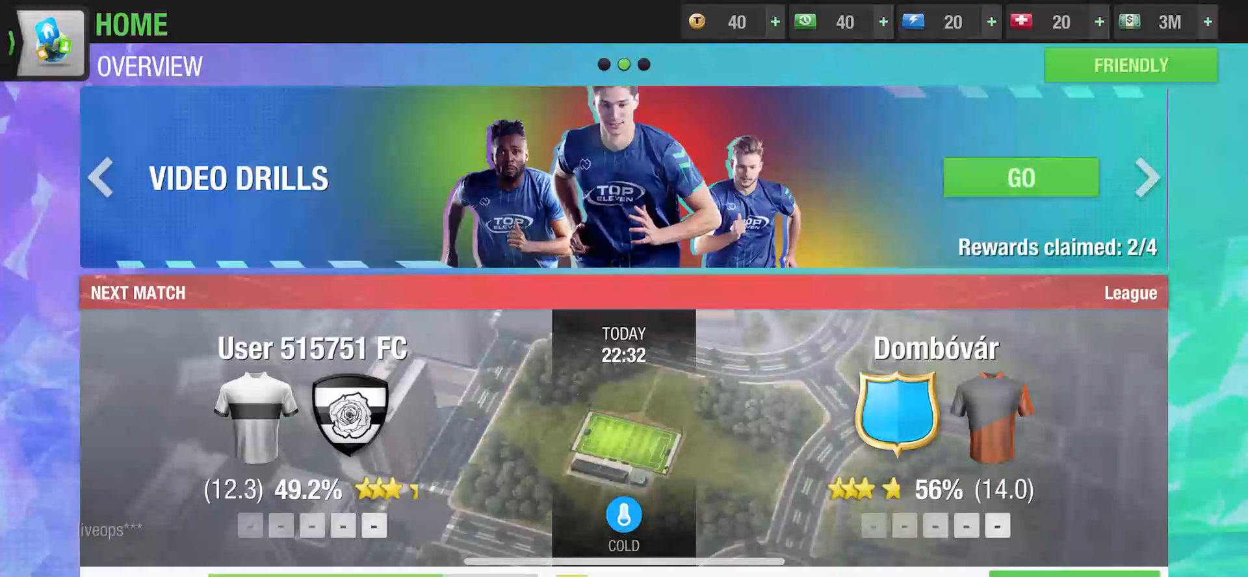

Slide 8

Key business questions
Does VALE generate incremental revenue?
Does VALE cannibalize traditional ads?

Slide 9
Data Overview
User stories dataset
~145k rows
~20k unique user
Ads dataset
~820k ad events
~3k users exposed to ads
Key assumptions:
Analysis is performed at user level
Users may interact with: regular ads, VALE ads, both

Slide 10
VALE is a relatively new feature in Top Eleven, and its goal is to monetize users that usually do not watch video ads on regular placements, nor are in-game payers (spend money directly in the gamE)

Slide 11
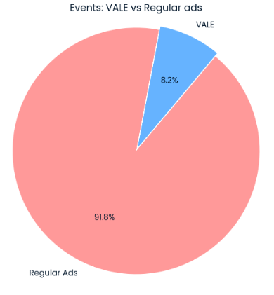
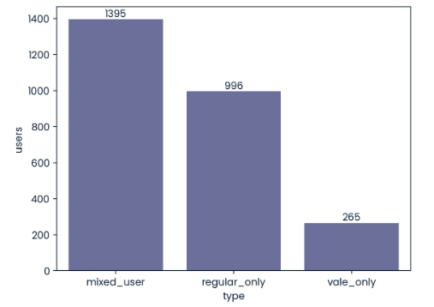
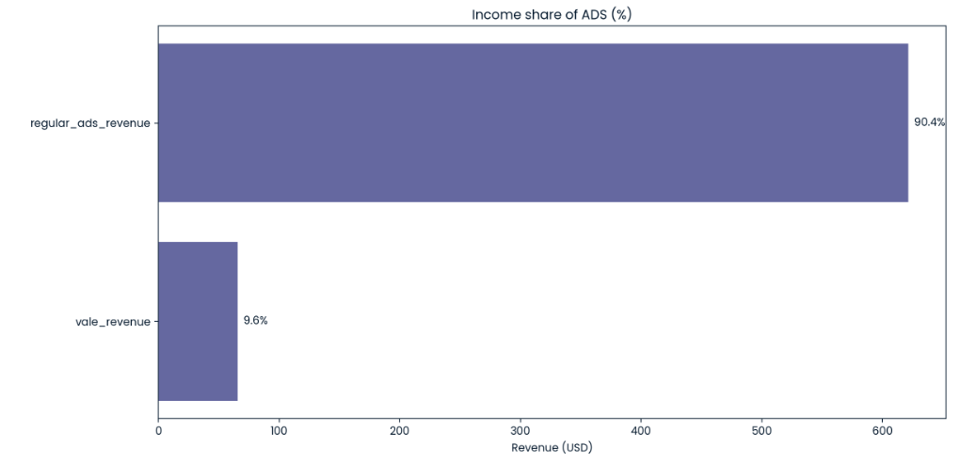
Business question #1
Approach
Identify users exposed to VALE ads
1.Split users into segments:
VALE-only
Mixed (VALE + regular ads)
2. Calculate VALE-related revenue separately
Key metric
Revenue generated exclusively from VALE ads

Slide 12
Findings
Total VALE revenue: $65.7
Revenue from VALE-only users: $3.23
VALE-only users represent a small but purely incremental segment
Interpretation:
Without VALE, this revenue would not have been generated.
VALE contributes additional monetization, primarily driven by mixed users.

Slide 13
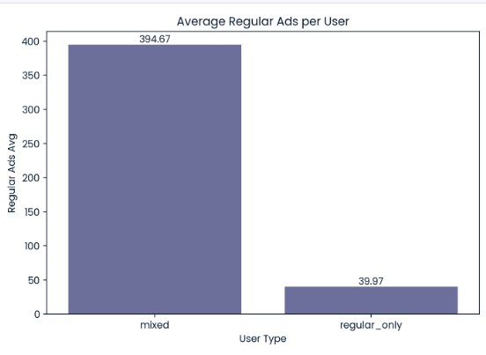
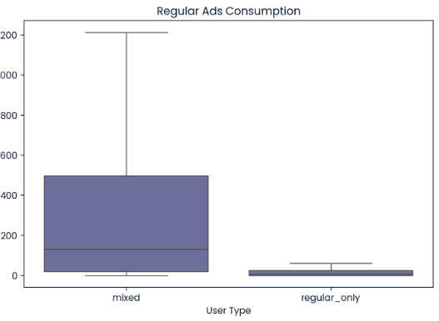
Business question #2
ApproacH*
Compare regular ad consumption between:
users who watch only regular
users who watch both VALE and regular ads
Key metric
Average number of regular ads per user
Data limitations
No user-level timelines
No “before / after VALE” markers
No control group
Direct cannibalization testing is not possible

Slide 14
Findings
Mixed users consume significantly more regular ads than regular-only users (>10 times in average)

Slide 15
Conclusions
Key insights
VALE generates incremental revenue
No evidence of cannibalization in observed data
VALE appears to be a complementary, not substitutive, ad format
Important note
1. Results are correlational.
2. A robust cannibalization assessment would require:
longitudinal user data
an A/B testing framework

Slide 16


Thank YOU!
This presentation was prepared as part of a test assignment.
The full project is available at the link below:
https://github.com/Zholly18/vale-top-11
SERGEI ZHOLUDEV
zholly18@gmail.com

